Slide 1
Chapter 2
e-Business Models

Slide 2
Learning outcomes
Describe an e-Business model and its importance
Describe e-Business relationship models
Describe e-Business marketplace communications and trading
Suggest the right e-Business model to use
Identify the tools that make e-Business work.

Slide 3
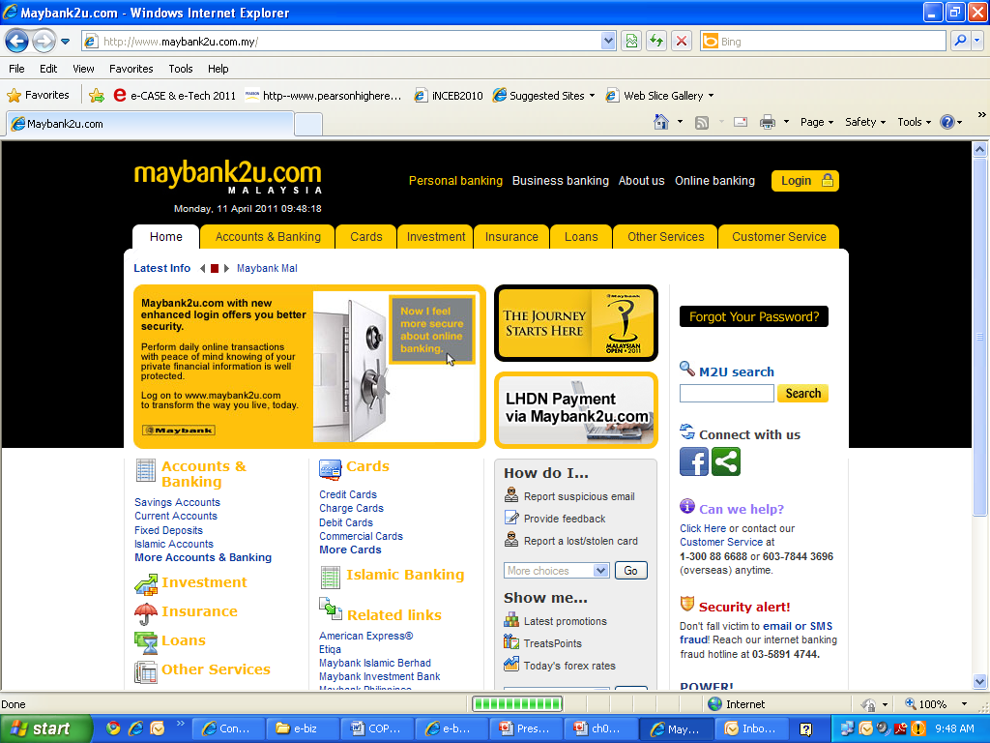
Examples- How this company makes money?

Slide 4
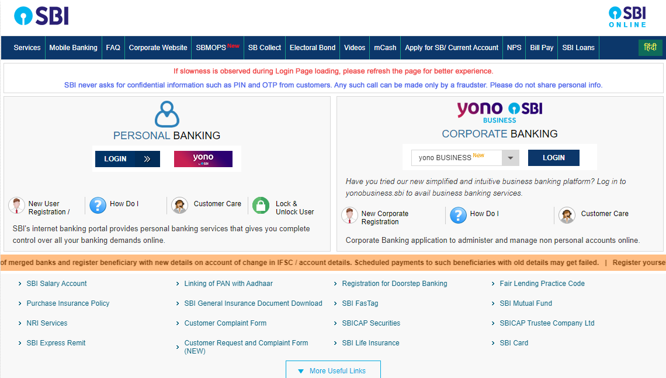

Slide 5
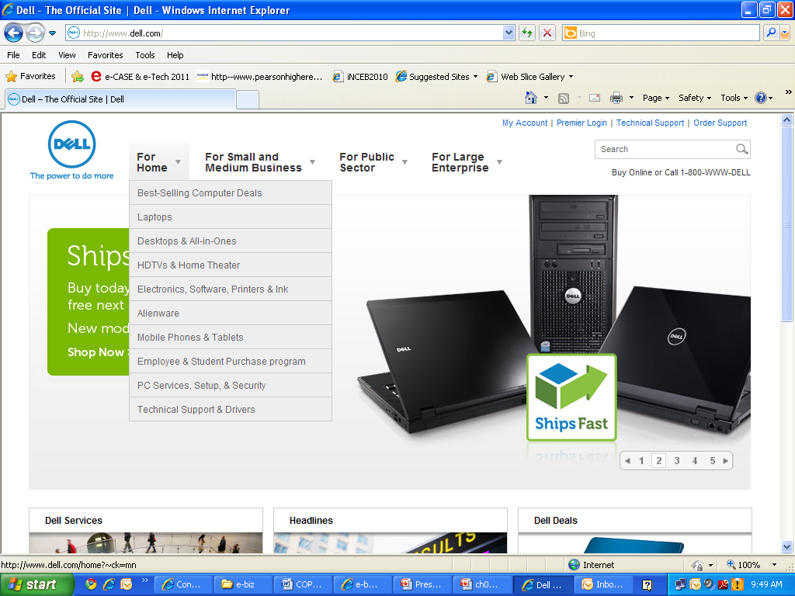
Examples- How this company makes money?

Slide 6
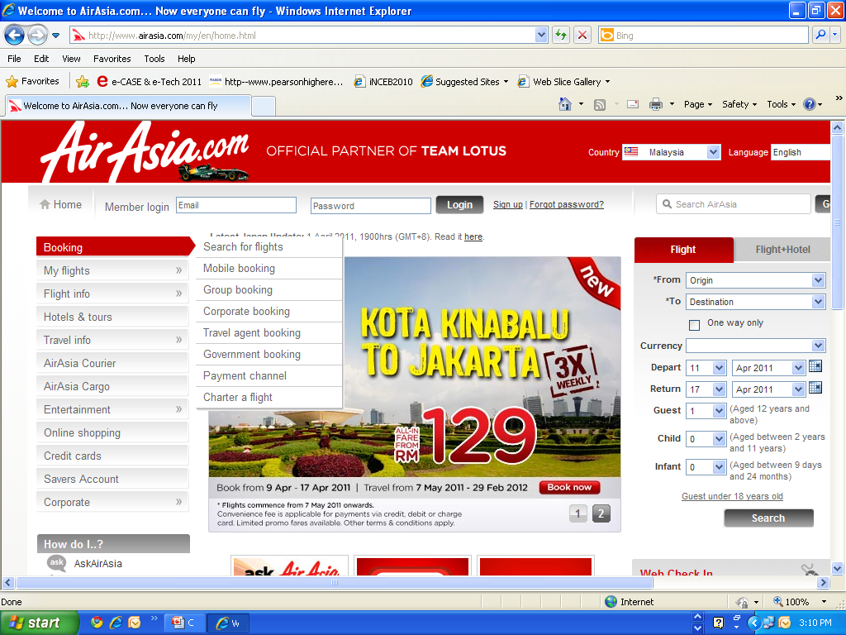
Examples- How this company makes money?

Slide 7
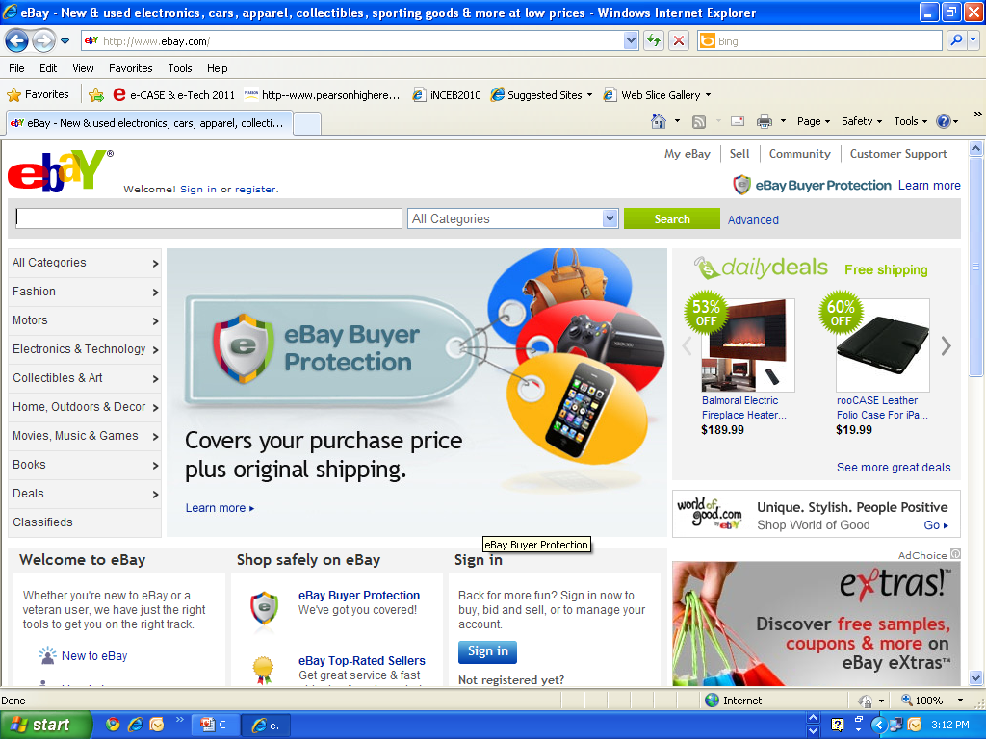
Examples- How this company makes money?

Slide 8
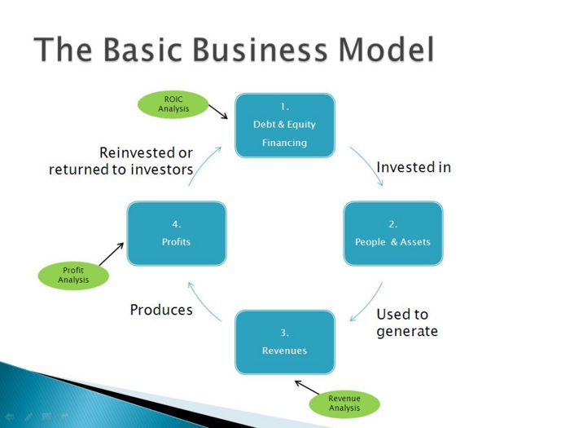
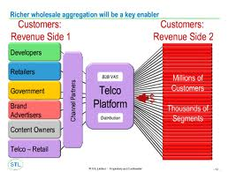
What is a business model?
Timmers (1999) defines a ‘business model’ as:
An architecture for product, service and information flows, including a
description of the various business actors and their roles; and
a description of the potential benefits for the various business actors; and
a description of the sources of revenue.

Slide 9
What is a business model?
In a conventional business method, a business model can also be described as,
“a method for enterprises to offer their products and services to customers and to sustain their competitive advantage for a long term” (Gottschalk, 2006).

Slide 10
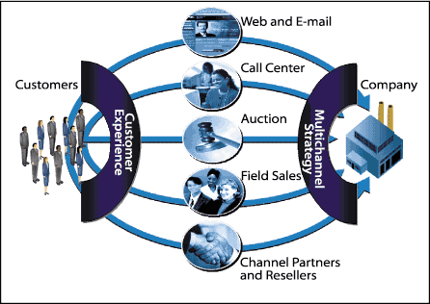
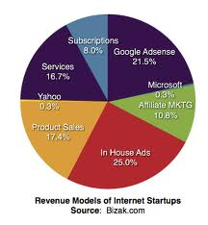
What is an e-business model?
A definition by Mc Gann and Lyytinen (2002) describes e-Business model as,
“an integration of business rules, a viable trading mechanism, and associated trading protocols into a business approach that leverage the open network (Internet) as its medium of transaction”.

Slide 11
What is an e-business model?
Another definition:
“a description of roles and relationships among a firm’s consumers, customers, allies and suppliers that identifies the major flows of product, information, money and the major benefits to the participants” (Weill and Vitale, 2001).

Slide 12
e-Business Model
Each enterprise that use the Internet should have an e-Business model-> how it plan to make money for a long term using the Internet.
Internet + non Internet activities
Planned or evolving
Making money $$$$
and keep the money coming

Slide 13
Components of e-Business Model
Business Model
customer value
scope
price
revenue sources
connected activities
implementation
capabilities
sustainability
Performance
Internet
Environment

Slide 14
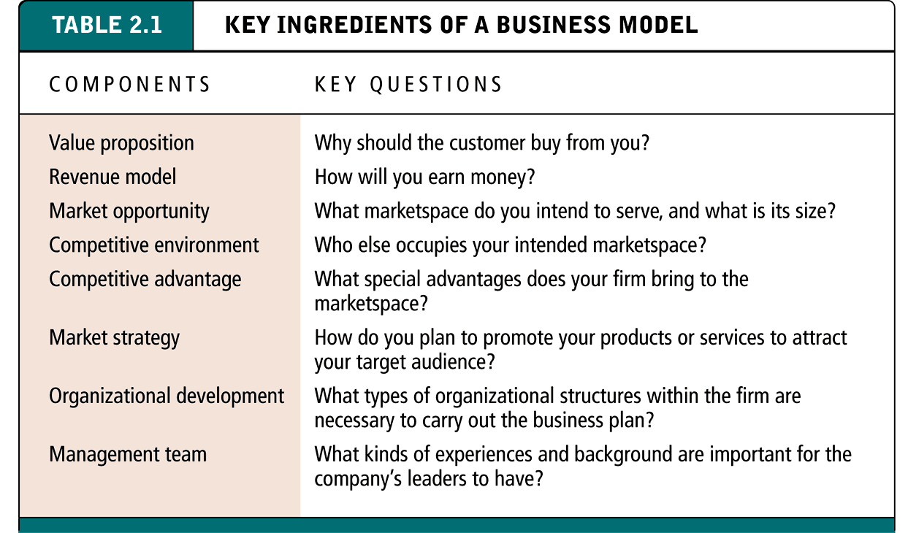
Key Ingredients of a Business Model

Slide 15
Value Proposition
Defines how a company’s product or service fulfills the needs of customers
Questions to ask:
Why will customers choose to do business with your firm instead of another?
What will your firm provide that others do not or cannot?
Examples of successful value propositions include:
Personalization/customization
Reduction of product search costs
Reduction of price discover costs
Facilitation of transactions by managing product delivery

Slide 16


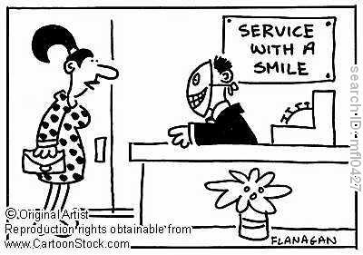
Components of e-Business Model
Customer value – What is customer value?
Differentiation
Product features
Timing
Location
Service
Product mix
Linkages
Brand name reputation
Low cost

Slide 17
Revenue Model
Describes how the firm will earn revenue, generate profits, and produce a superior return on invested capital
Terms financial model and revenue model often used interchangeably
Major types:
Advertising revenue model
Subscription revenue model
Transaction fee revenue model
Sales revenue model
Affiliate revenue model

Slide 18
Components of e-Business Model
Scope
Market segment /geographic area
Businesses
Different industries
Sizes
Technical sophistication
Household
Demographic
Lifestyle
Incomes
Example: an e-Business company that targets teenagers must decide how much of their customers’ needs it wants to meet.

Slide 19
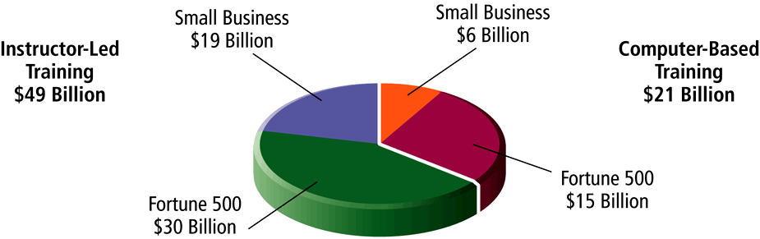
Marketspace and Market Opportunity in the Software Training Market
Figure 2.1, Page 67

Slide 20


Components of e-Business Model
Price
Require good pricing strategy
Dynamic pricing
Menu/ fixed pricing
One-to-one bargaining
Auction
Reverse auction
Barter –
to trade without exchange
of money

Slide 21
Components of e-Business Model
Revenue sources
Determine the source of revenue
Commission
Interest
The spread between the bid and the price of stocks
Connected activities- what and when
What
Activities to perform must be consistent with customer value and scope
Reinforce each other
Gain advantage from industry success drivers
Gain advantage from any distinctive advantages
Gear towards building the image
When
Market situation
Competitors doing
Customers demand

Slide 22
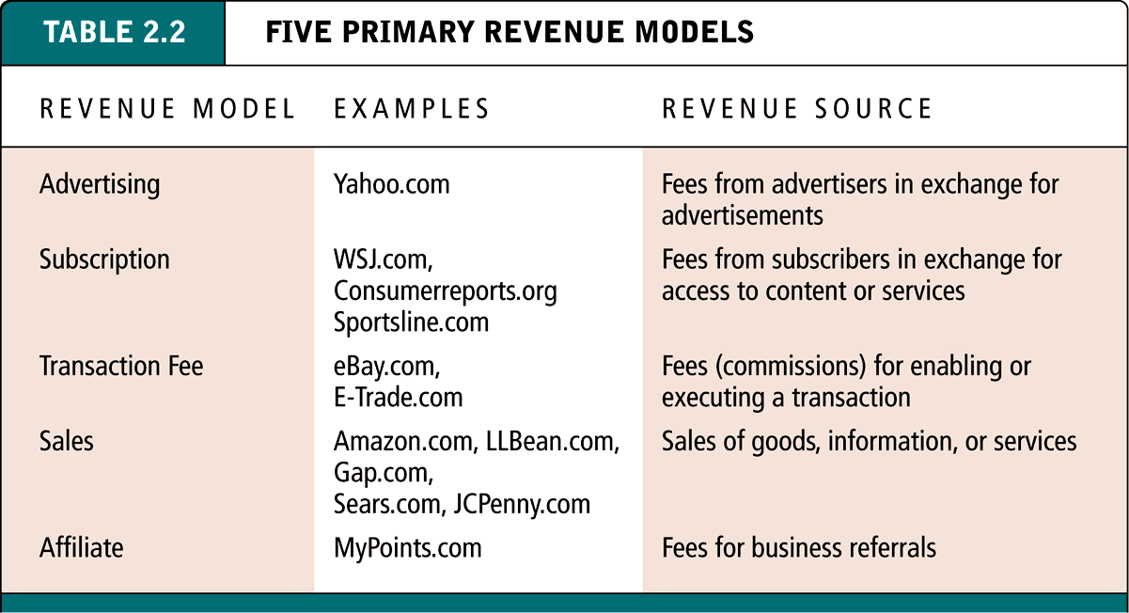
Five Primary Revenue Models
Table 2.2, Page 66

Slide 23
Criteria To Determine An E-business Model
A few criteria to determine an e-Business model (Weill and Vitale, 2001) such as :
Involved parties – business to business, business to customer or customer to customer.
Revenue sources – transaction fee, product price, and/or exposure fee.
Value configuration – value chain, value shop and/or value network.
Integration with customers or suppliers.
Relationships – one to one, one to many, and many to many and/or many to one.
Knowledge – know-how, know-what and know-why

Slide 24
Types of e-Business Model (source: Weile & Vitale, 2001)
E-Business models | Description
Direct to customer | The buyer and seller is communicating directly The seller act as a retailer, wholesaler or a manufacturer. The customer can be an individual or a business. Emphasizes on application infrastructure, communication and IT management. Example: Dell Computer Corporation, selling a custom made products direct to the customers (see www.dell.com).
Full service provider | Allows an enterprise to provide total coverage of customer’s needs in a particular domain. Example, the customer seeks for advice on health care services thus it will add value to the enterprise by offering a full range of services and consolidate them into the customer chosen channel. Example: Prudential Advisor
Whole of enterprise | Provides customers a single point of contact to the enterprise by provision of goods and services through business units. Commonly used by the public-sector organizations. Example: Myeg.com.my, represents government agencies such as ‘Jabatan Pengangkutan Jalanraya (JPJ)’ that provides various services for the public (see www.myeg.com.my).

Slide 25
Types of e-Business Model
E-Business models | Description
Intermediaries | Used in portals, agents, auctions and other intermediaries. The intermediaries are represented by websites . Example, a travel agency can be an intermediary for the airlines company, hotels and other accommodations required by customers. For customers, the intermediary website is a one stop centre that provide all the necessary services that can ease their tasks – www.agoda.com
Shared infrastructure- | The enterprise will provide an IT infrastructure to be shared among its owners. It allows the customers to access the shared infrastructure for selecting and viewing the suppliers and their value propositions. The chosen supplier will complete the transaction by providing the products or services to the customers. Example: Yahoo.com provides an infrastructure for services and products placement (see www.yahoo.com).
Virtual community | The enterprise who owns or sponsors the virtual community will be a moderator that manages the members of the community. Depends on available members, system’s privacy and security and leveraging the members profile information for marketing purposes, etc. Example: Facebook

Slide 26
Types of e-Business Model
E-Business models | Description
Value net integrator | Adds value by improving the effectiveness of virtual value chain through gathering, synthesizing and distributing of information to all the players in the model. Example: Cisco System provides various software and hardware for other businesses (see www.cisco.com)
Content provider | Creates and provides content such as information, products, or services in digital format to customers via third parties. Digital products can be software, music, video or movie and etc. Example: Gua.com, a website that allow customers to watch movie online (see www.gua.com.my, tonton.com.my) and Amazon.com that provides book reviews (see www.amazon.com)

Slide 27
Business Models
E-shop
E-procurement
E-mall
E-auctions - ebay
Virtual community
Collaboration platforms
Third-party marketplace
Value chain integrators
Value-chain service provider
Information brokerage
Trust and other services

Slide 28
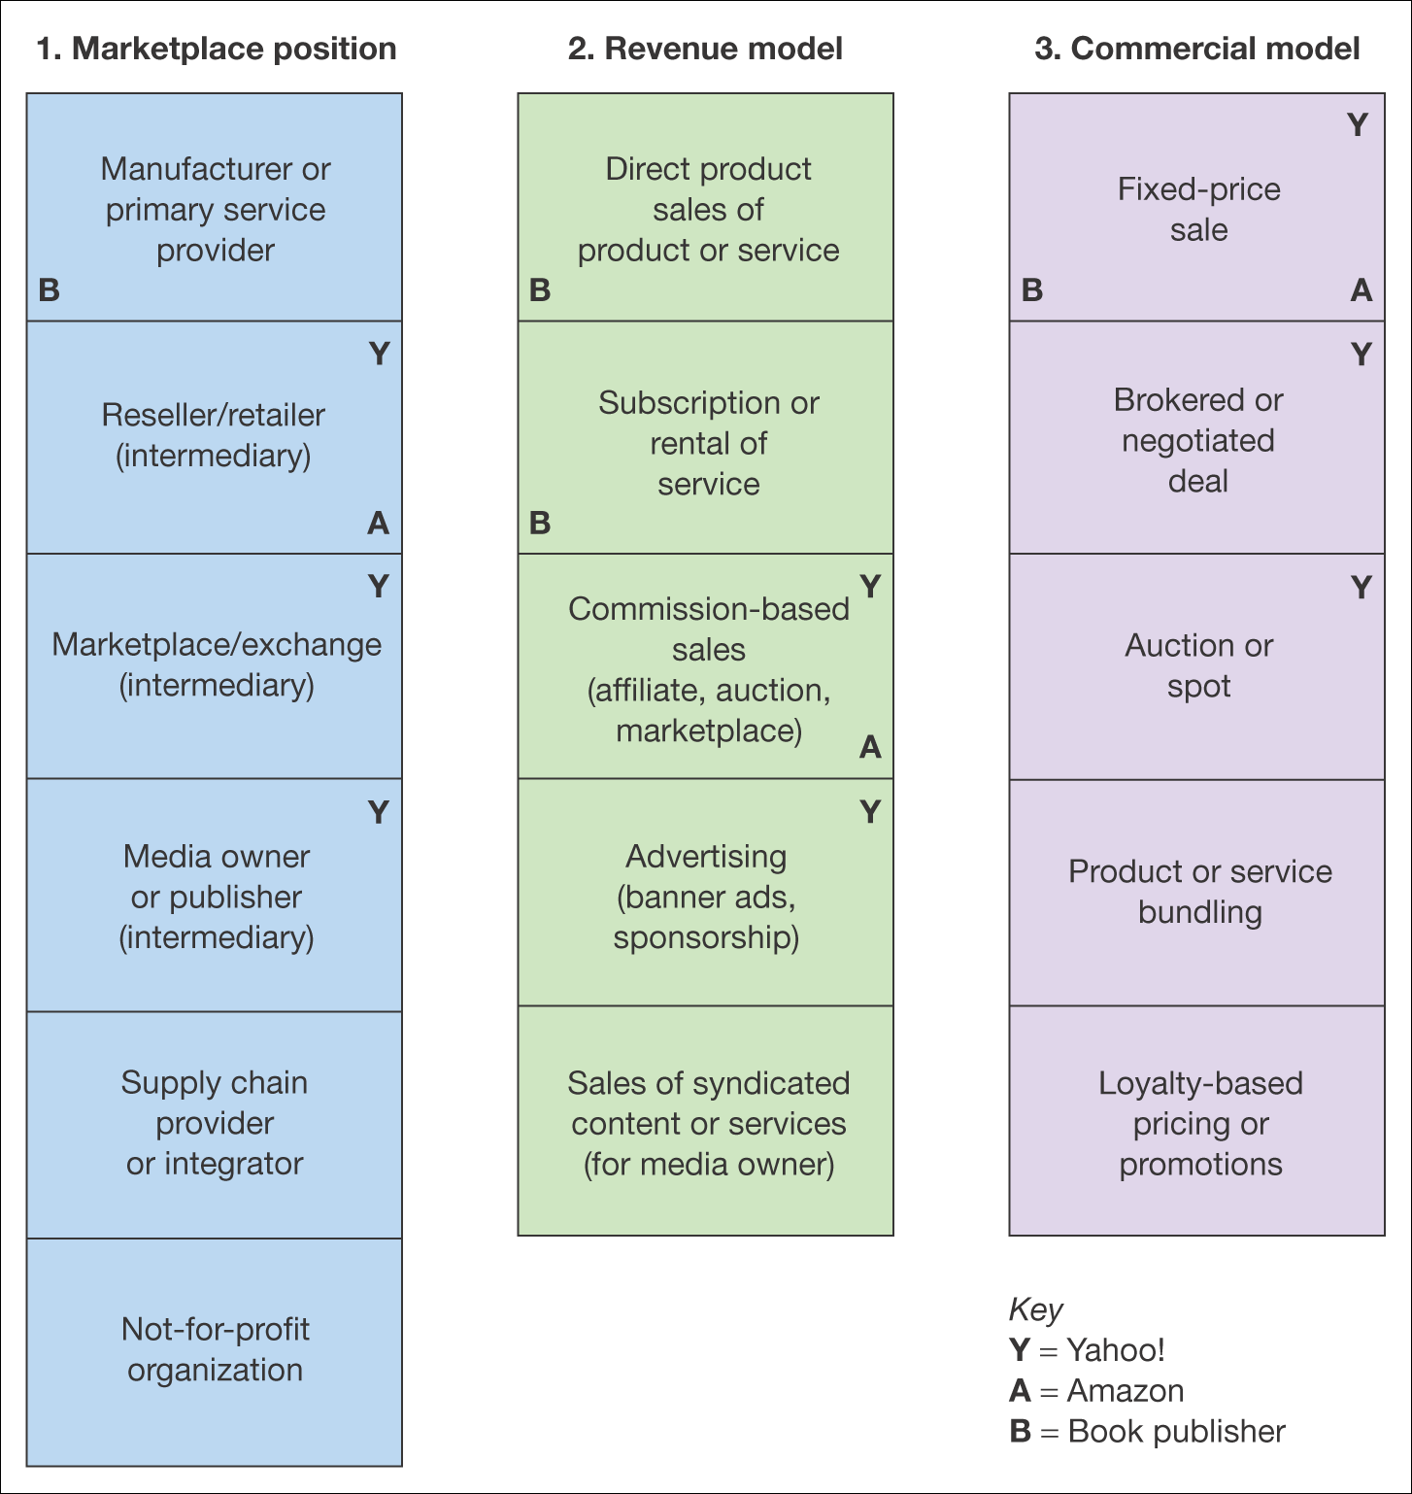
Example :
Figure 2.10 Alternative perspectives on e-business models (source: Chaffey, 2007)

Slide 29
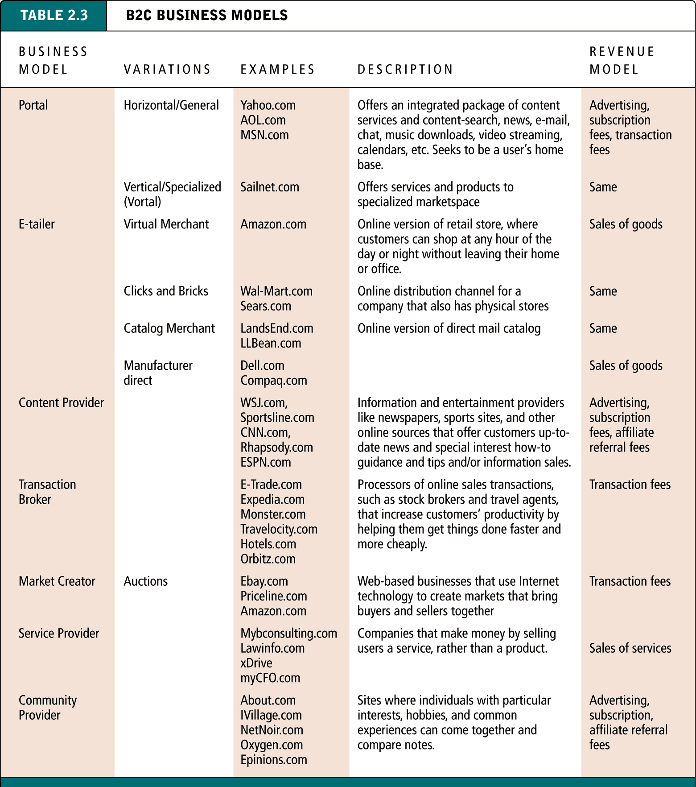
B2C Business Models

Slide 30
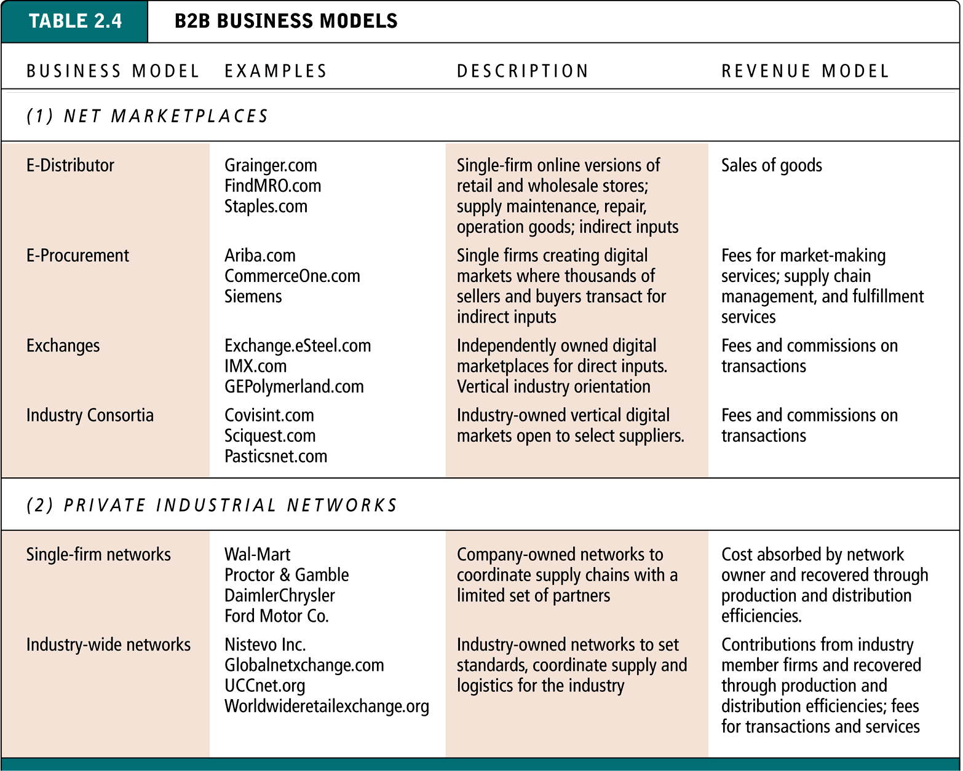
B2B Business Models
Table 2.4, Page 82

Slide 31


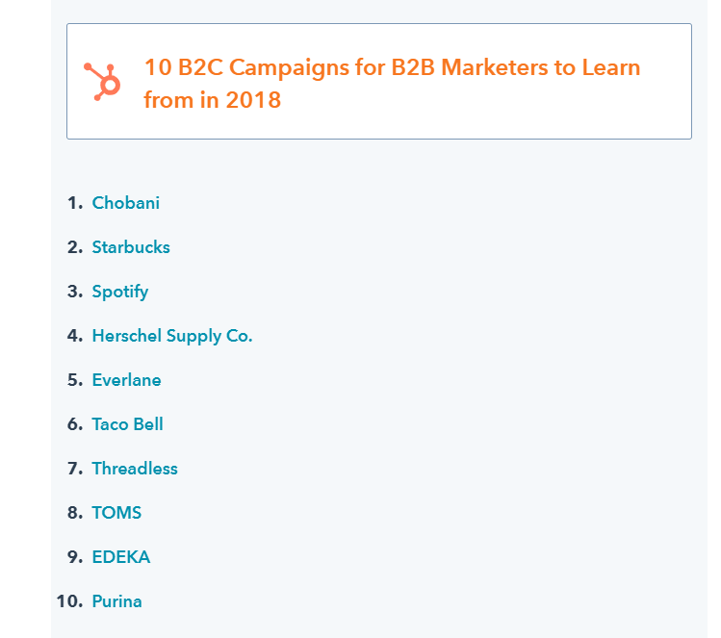
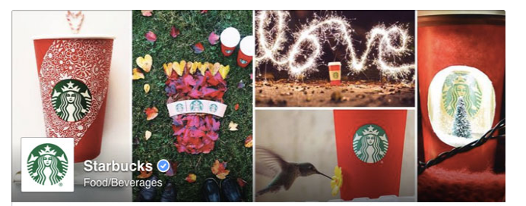

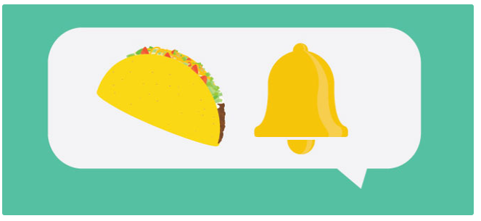
B2C

Slide 32
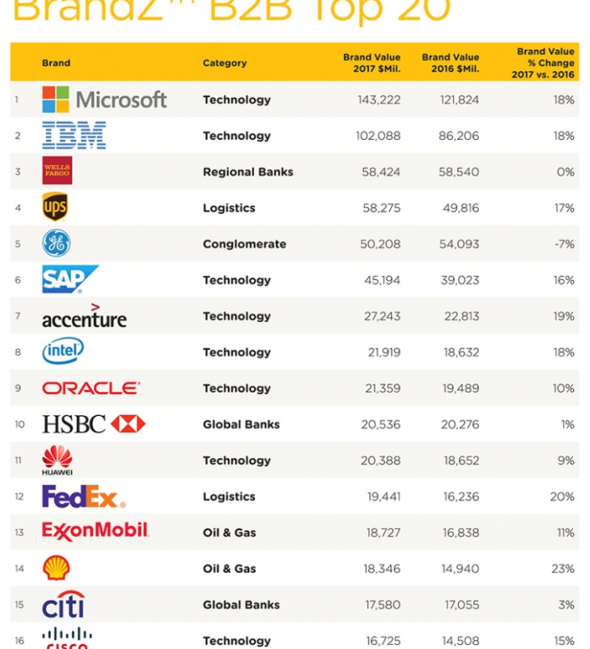
B2B

Slide 33
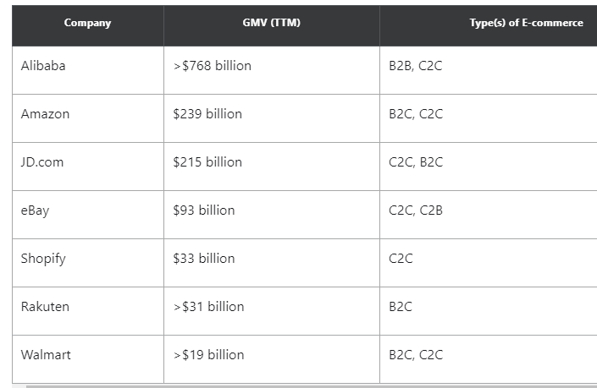
C2C

Slide 34
Ariba
Ariba was founded in 1996^{[4]} by Bobby Lent, Boris Putanec, Paul Touw, Rob Desantis, Ed Kinsey, Paul Hegarty, and Keith Krach^{[5]}on the idea of using the Internet to enable companies to facilitate and improve the procurement process. Procurement had been a paper-based, labor-intensive, and inefficient process for large corporations;

Slide 35
Convisint
“Our customers have deployed our B2B Cloud Platform to connect to over 212,000 of their business partners and customers – transacting in excess of $1 trillion per year. This allows more than 25 million users to access the trusted information and mission–critical applications provided by our customers.”

Slide 36
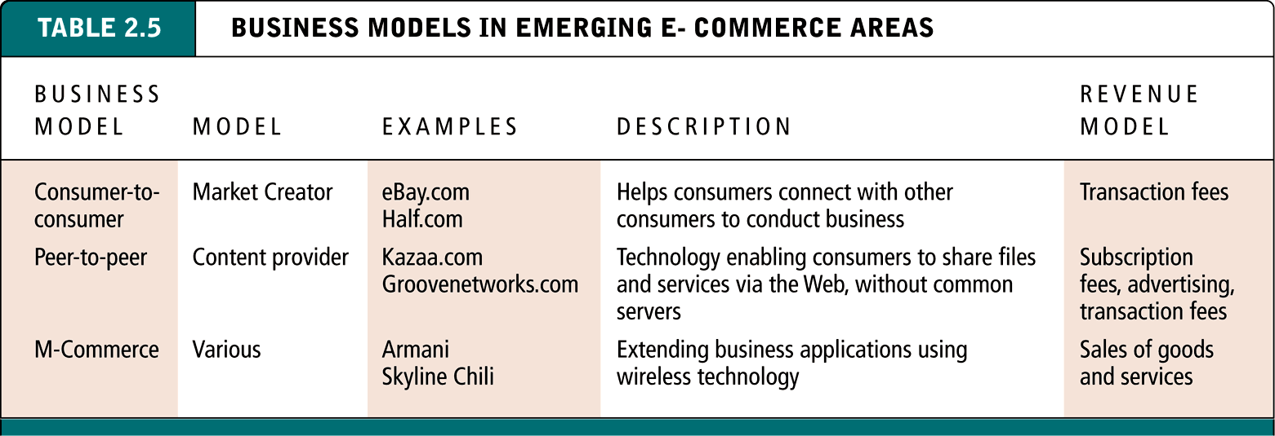
Business Models in Emerging E-commerce Areas
Table 2.5, Page 88

Slide 37
Example: Book publisher
Subscription fee
Sponsorship
Pay-per-view access
Publisher
Affiliate revenue (CPA/CPC)
CPC advertising
Subscriber for email marketing
CPM on site
Access to customers

Slide 38
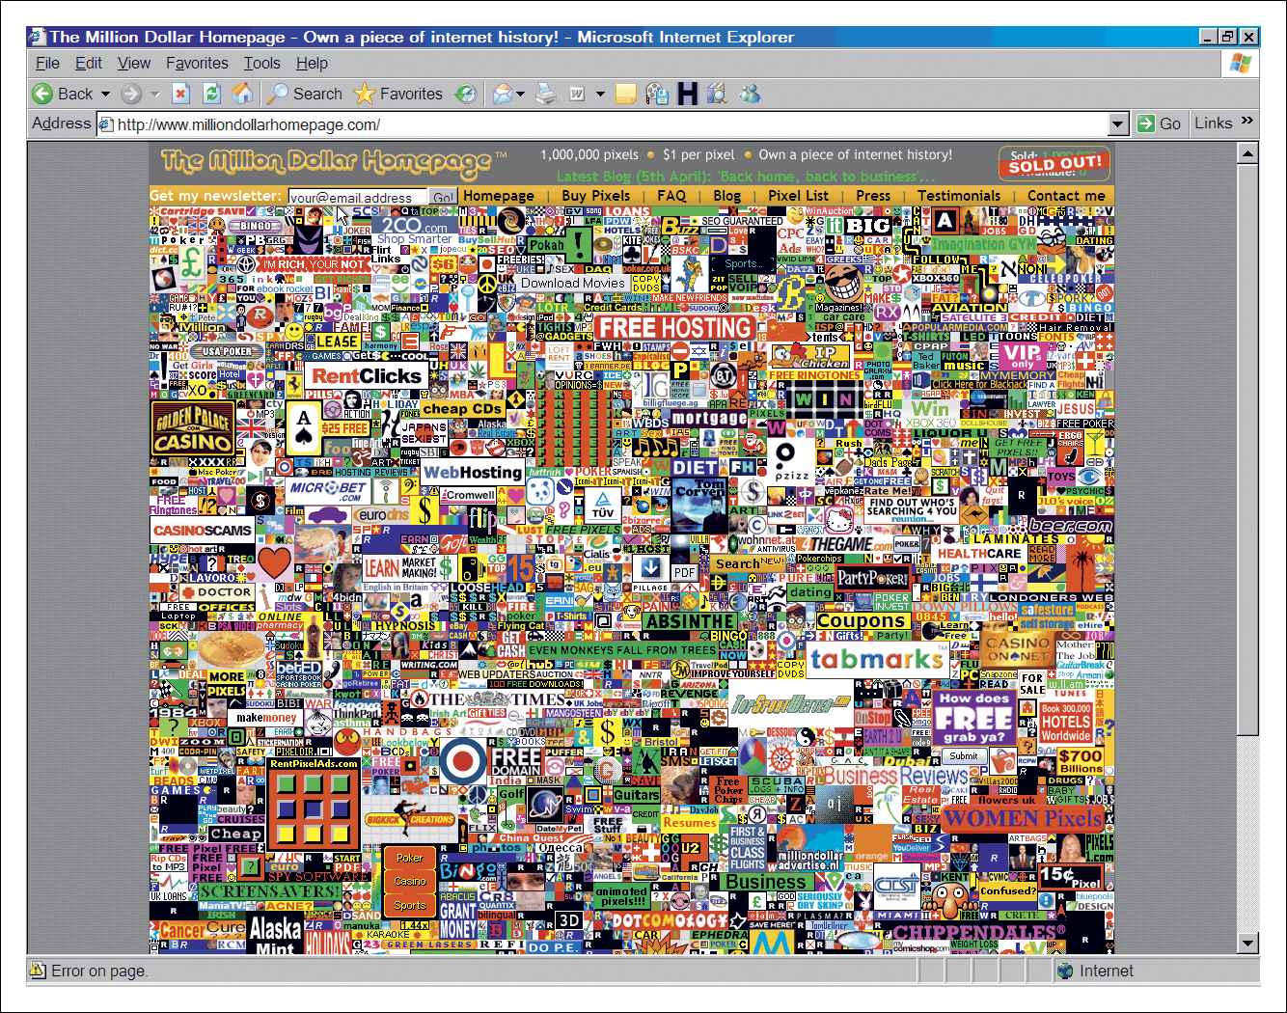
Another Example
Figure 2.11 Alex Tew’s Million Dollar Home Page (www.milliondollarhomepage.com) : (source: Chaffey, 2007)

Slide 39
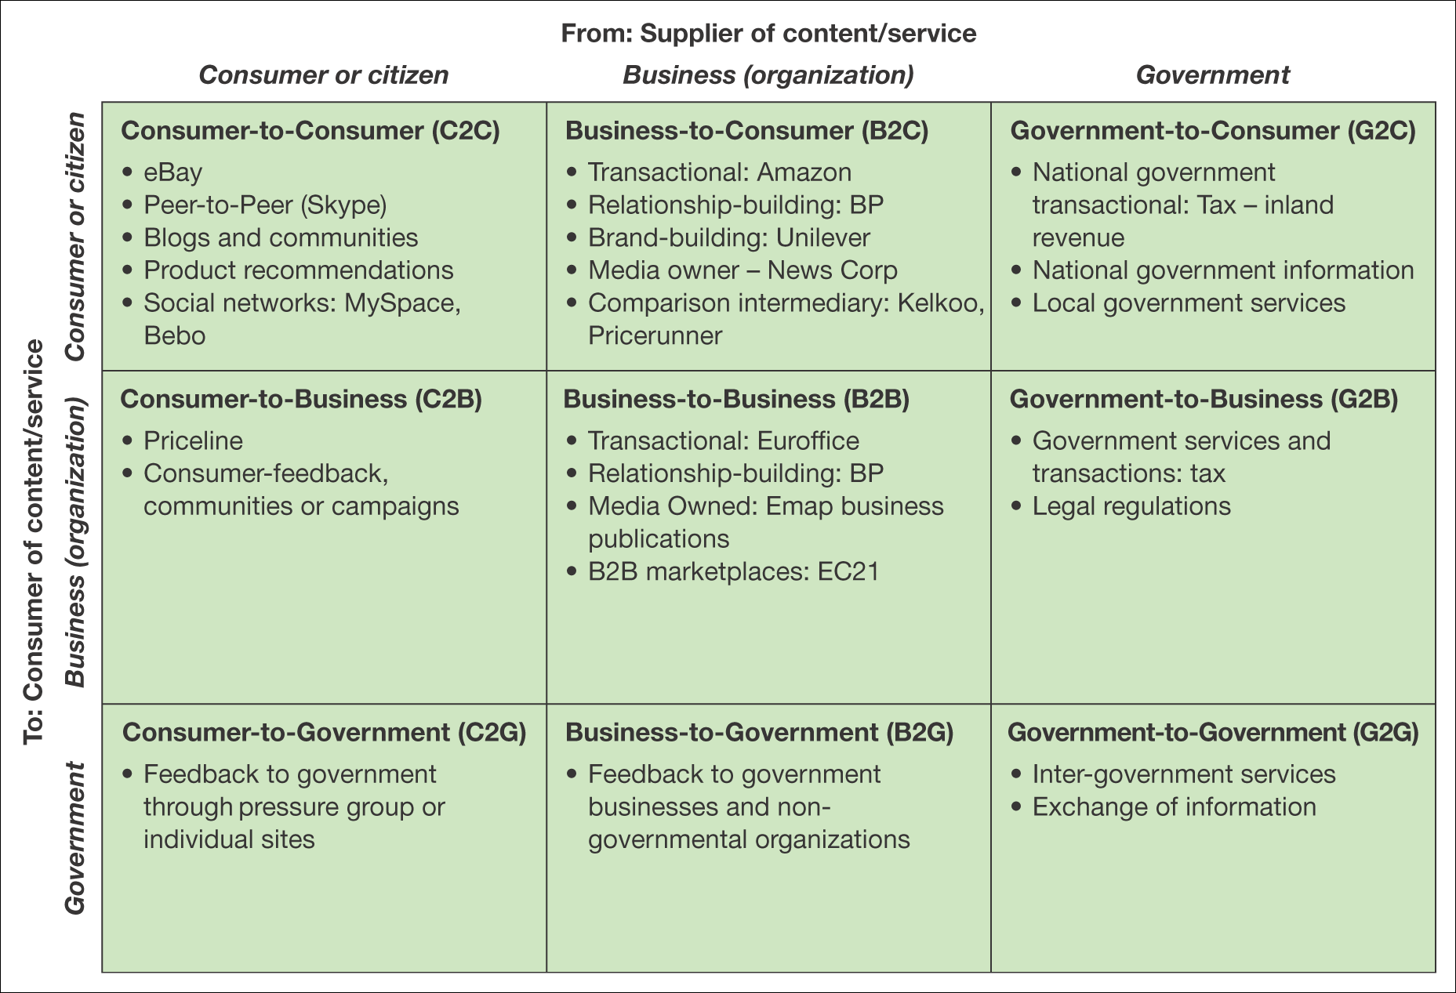
Business Relationship Models
Figure 1.2 Summary and examples of transaction alternatives between businesses, consumers and governmental organizations (source: Chaffey, 2007)

Slide 40
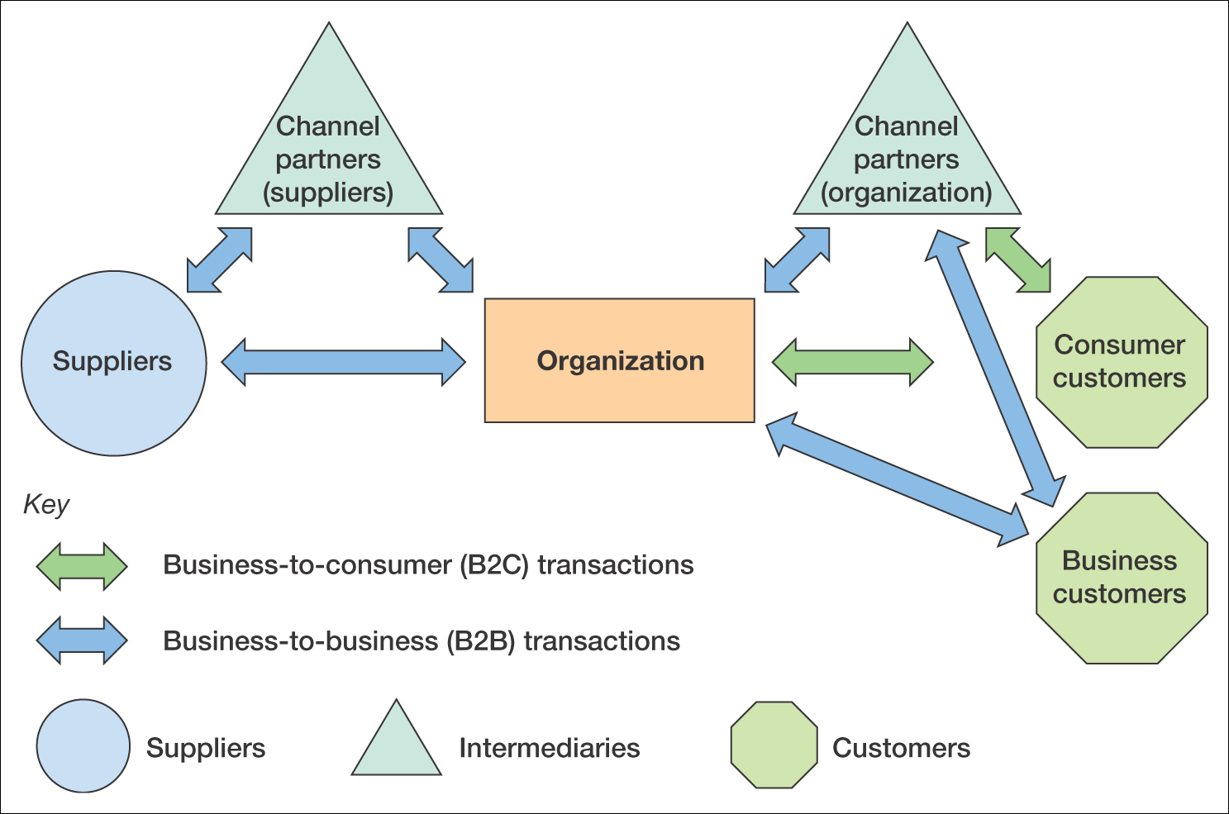
Business Relationship Models
Figure 2.2 B2B and B2C interactions between an organization, its suppliers and its customers (source: Chaffey, 2007)

Slide 41
B2B and B2C characteristics
Characteristic | B2C | B2B
Proportion of adopters with access | Low to medium | High to very high
Complexity of buying decisions | Relatively simple – individual and influencers | More complex – buying process involves users, specifiers, buyers, etc.
Channel | Relatively simple – direct or from retailer | More complex, direct or via wholesaler, agent or distributor
Purchasing characteristics | Low value, high volume or high value, low volume. May be high involvement | Similar volume/value. May be high Involvement. Repeat orders (rebuys) more common
Product characteristic | Often standardized items | Standardized items or bespoke for sale

Slide 42
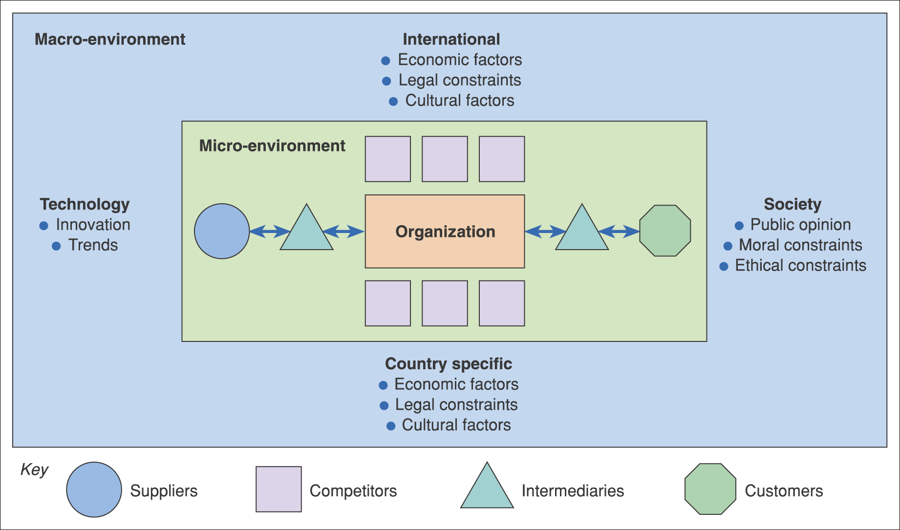
Figure 2.1 The environment in which e-business services are provided

Slide 43
Environment constraints and opportunities
Customers – which services are they offering via their web site that your organization could support them in?
Mumbai university has started sending papers online and passward via sms, are you in a position to suport them in with H/w s/W
Competitors – need to be benchmarked in order to review the online services they are offering – do they have a competitive advantage?
Is it going to increase my sell?
Intermediaries – are new or existing intermediaries offering products or services from your competitors while you are not represented?
Suppliers – are suppliers offering different methods of procurement to competitors that give them a competitive advantage?

Slide 44
Environment constraints and opportunities (Continued)
Macro-environment
Society – what is the ethical and moral consensus on holding personal information?
Country specific, international legal – what are the local and global legal constraints for example, on holding personal information, or taxation rules on sale of goods?
Country specific, international economic – what are the economic constraints of operating within a country or global constraints?
Technology – what new technologies are emerging by which to deliver online services such as interactive digital TV and mobile phone-based access?

Slide 45
Marketplace Channel Structure
It describes the way a manufacture / supplier delivers products and services to its customers

Slide 46
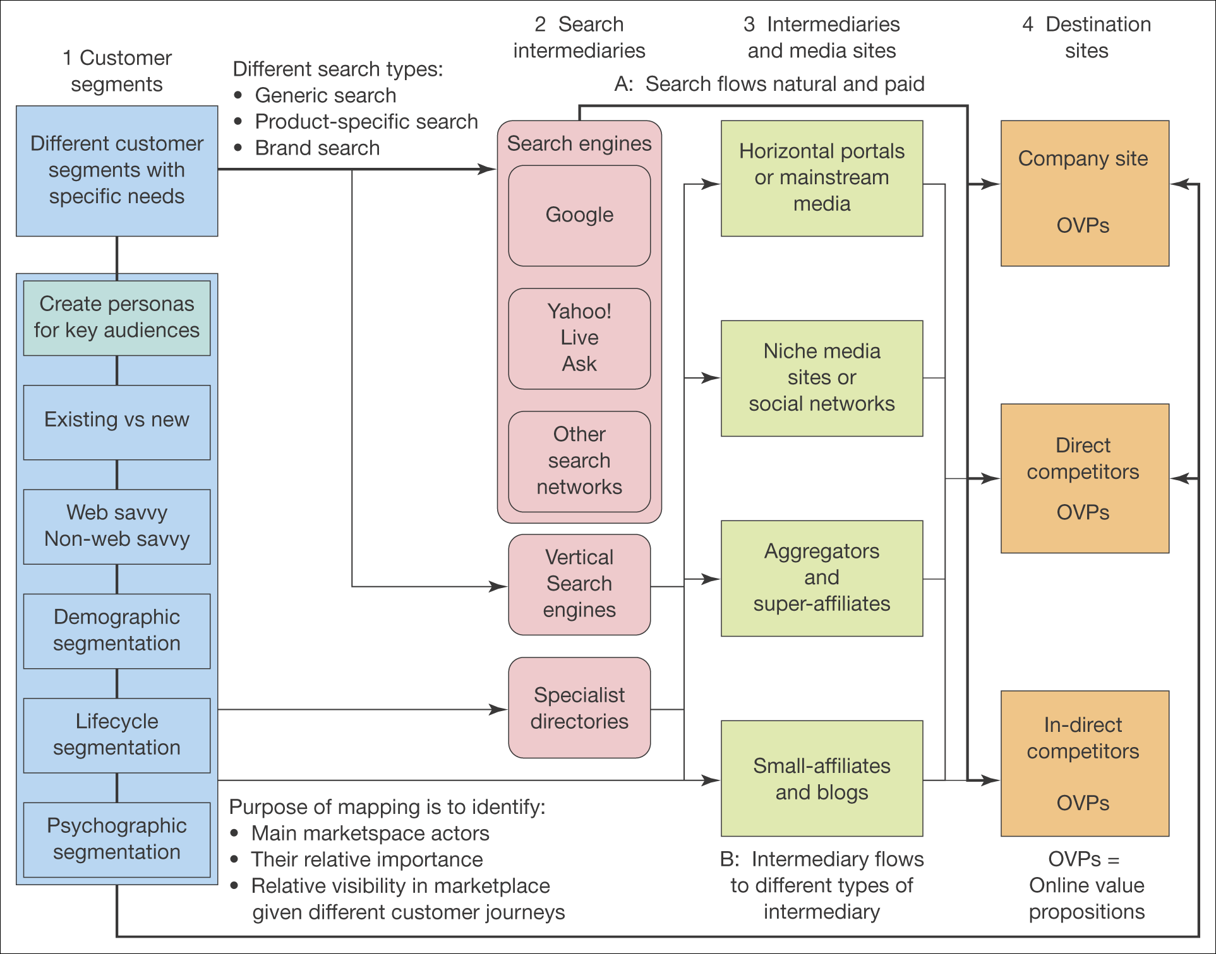
Psychographics - personality, values, opinions, attitudes, interests, and lifestyles.
Figure 2.3 An online marketplace map

Slide 47
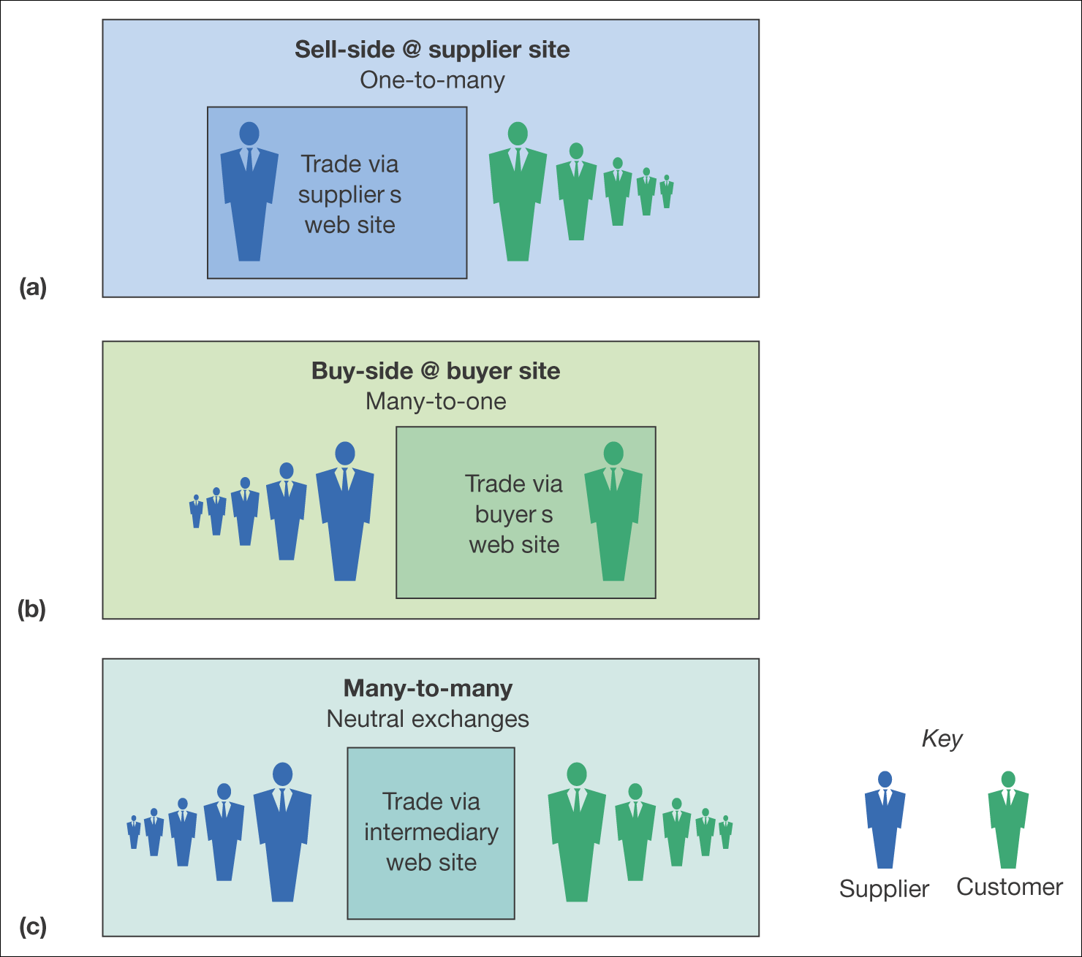
E-Marketplace
Figure 2.8 Variations in the location and scale of trading on e-commerce sites

Slide 48
Different places for online representation
Seller-controlled – vendor sites – home site of organization selling products - dell
Seller oriented – intermediaries controlled by third parties to the seller such as distributors and agents
Neutral – auction space – ebay
Comparison site
Product specific search engines
Buyer oriented – intermediaries controlled by buyers
Buyer-controlled – web-site procurement posting on company’s own site. - GE

Slide 49
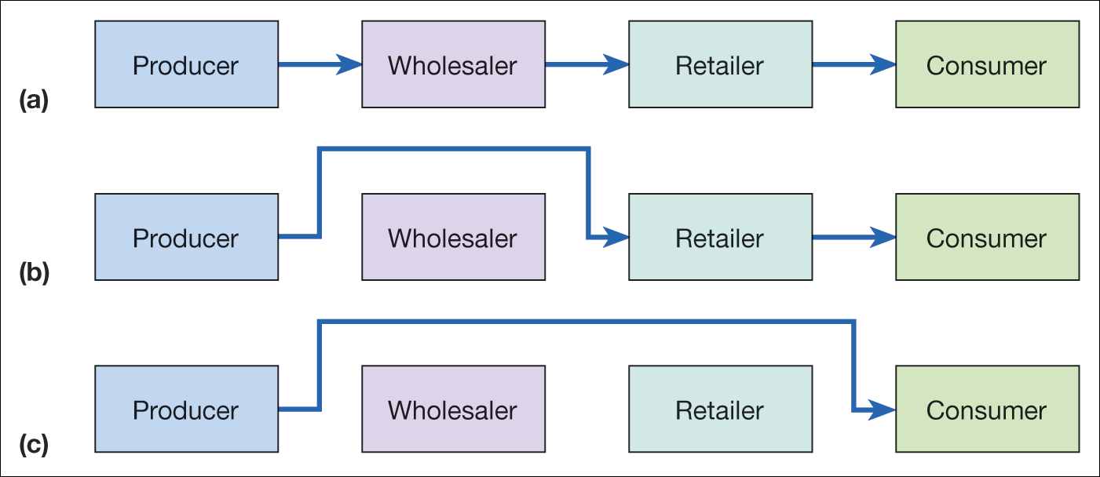
Marketplace Channel Structures
Figure 2.3 Disintermediation of a consumer distribution channel showing (a) the original situation, (b) disintermediation omitting the wholesaler, and (c) disintermediation omitting both wholesaler and retailer

Slide 50
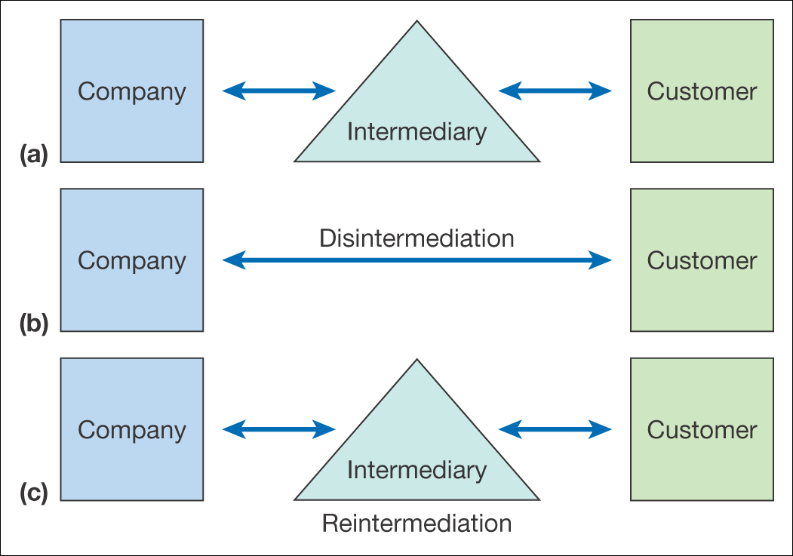
Marketplace Channel Structures
Describes the way a manufacturer delivers products and services to its customers
Figure 2.4 From original situation (a) to disintermediation (b) and reintermediation (c)

Slide 51
Online Intermediaries: Examples
Directories
Search Engines
Malls
Virtual resellers
Financial Intermediaries
Forums, fan clubs and user groups
Evaluators
Customer
Company
Inter-mediary
Customer
Customer

Slide 52
Multi-channel Marketplace Models
Customer journey – modern multi-channel behavior as consumers use different media
Offline
Mixed-mode
Online

Slide 53
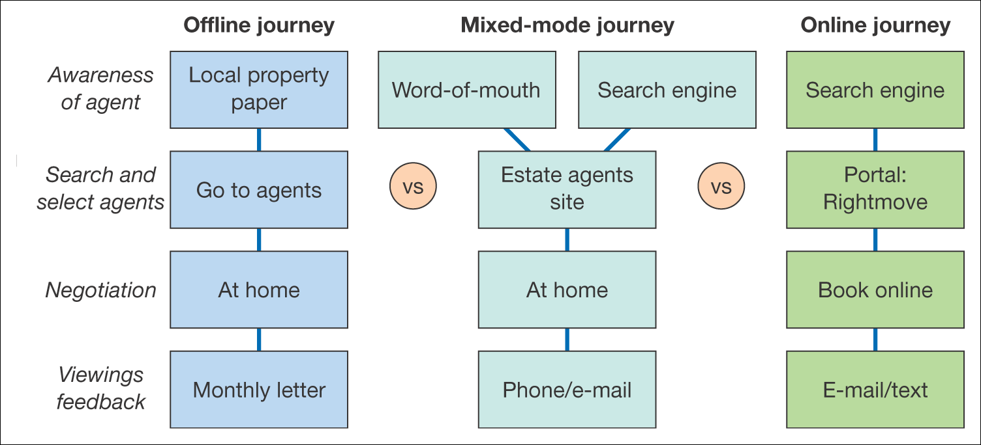
Multi-channel Marketplace Models
Figure 2.7 Example channel chain map for consumers selecting an estate agent to sell their property

Slide 54
E-Business Tools
Blogs
Give an easy method of regularly publishing web pages, e.g. online journals, diaries or event listing
Include feedback or comments
Portal
‘A gateway to information resources and services’
Social network applications
Forum/bulletin
Search engine
Etc.

Slide 55
Revenue Model- Publisher Example
Advertising CPM (cost per thousand/mille)
Advertising CPC (cost per click)
Sponsorship of section, content, or widget
Affiliate Revenue (CPA or CPC)
Transaction Fee
Subscription access to content or services
Pay-per-view Access to document
Subscription Data Access for e-mail Marketing

